Slide 1
AI IN FINANCIAL SERVICES
DEFECT DETECTION FOR LAPTOPS
Industry Mentor
Manu Sharma
Hewlett Packard Enterprise(HPE)
Gayathri R 22i218
Vinithaa P 22z273
Kiruthika Sermadurai 22z336
Sanjitha R 22z259
Durga G 22z321
Academic Mentor
Dr.Suriya S
CSE Department
PSG College of Technology

Slide 2
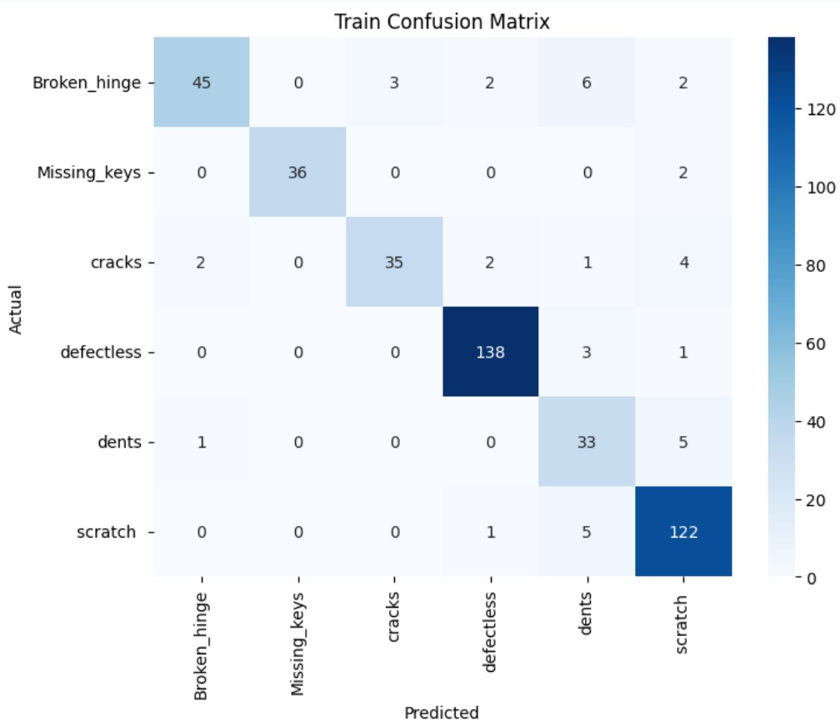

Resnet-50
Training Accuracy: 97.83% Validation Accuracy: 85.93%

Slide 3
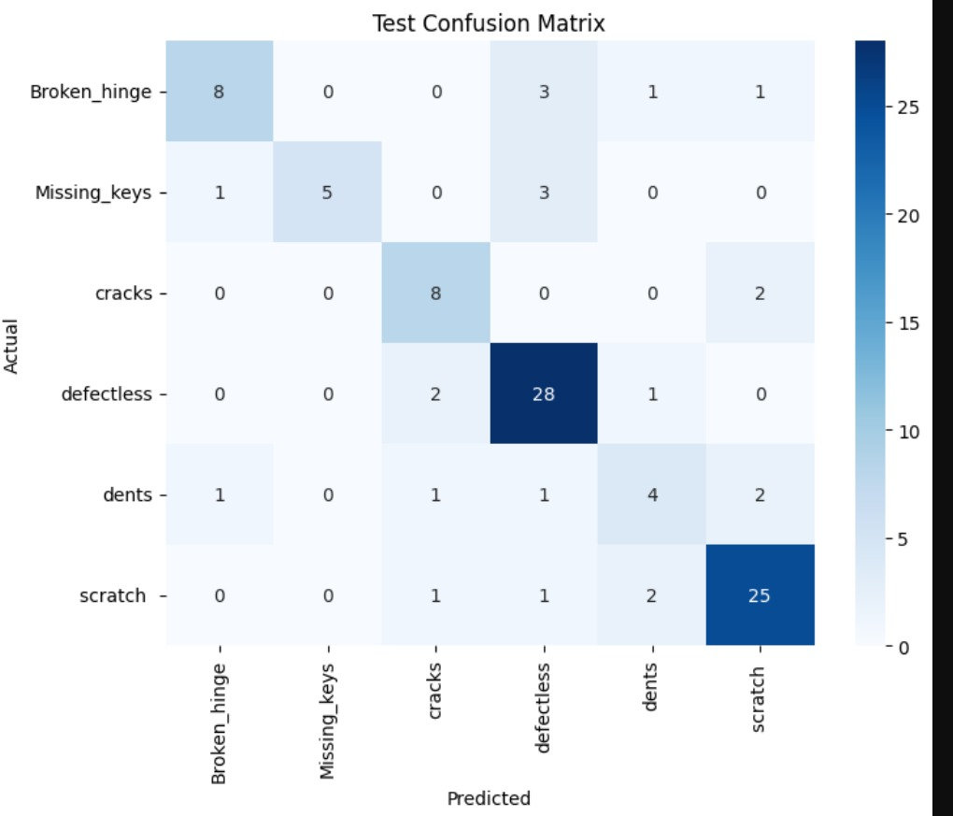
Resnet-50
Test Accuracy: 78.12%

Slide 4
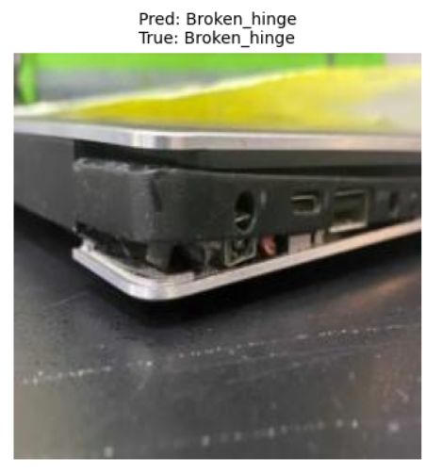
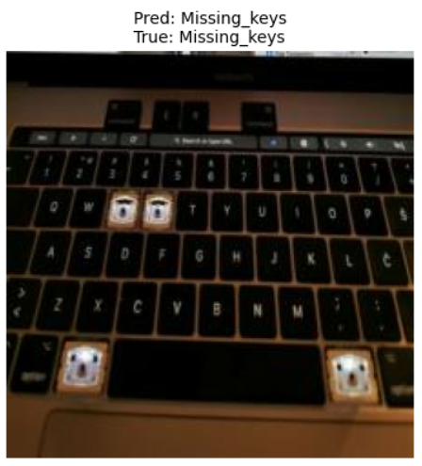
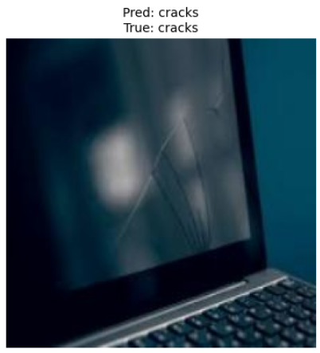
Resnet-50

Slide 5
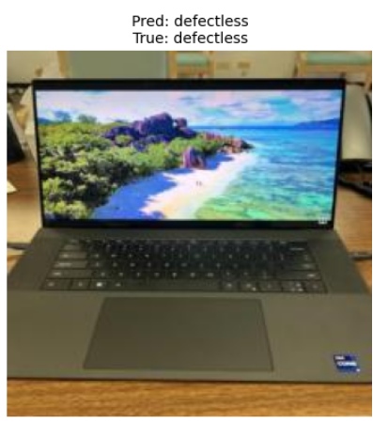
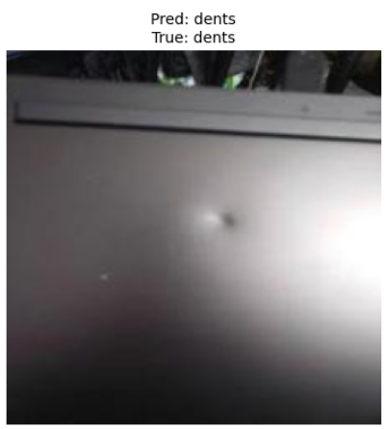
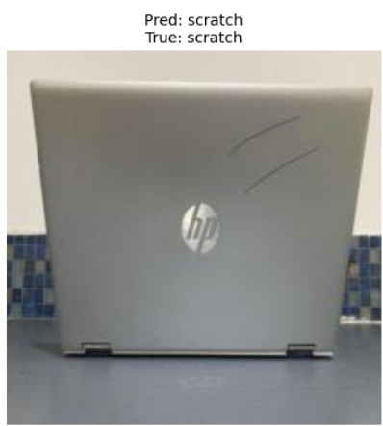
Resnet-50

Slide 6


MobileNetv2
Training Accuracy: 83.96% Validation Accuracy: 85.11%

Slide 7

MobileNetv2
Test Accuracy: 77.23%

Slide 8
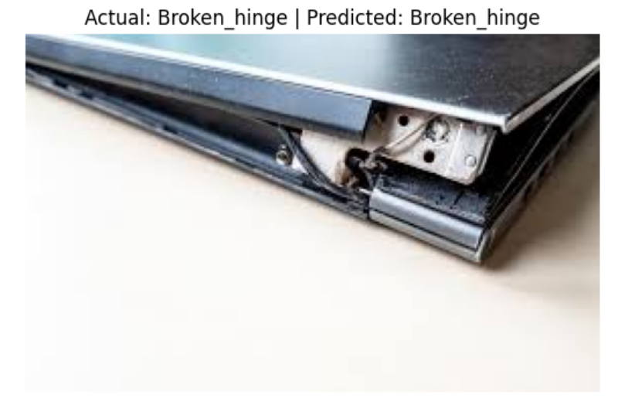
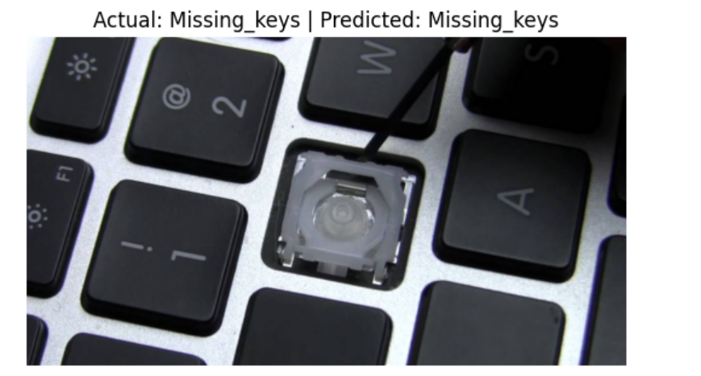
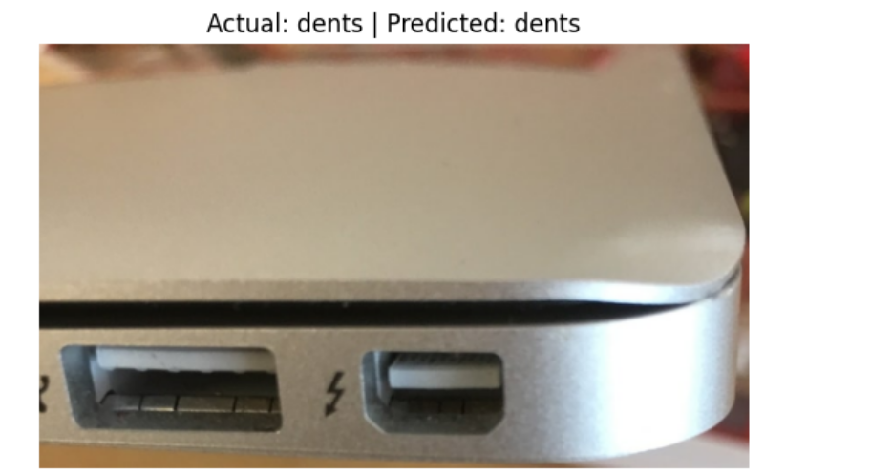
MobileNetv2

Slide 9
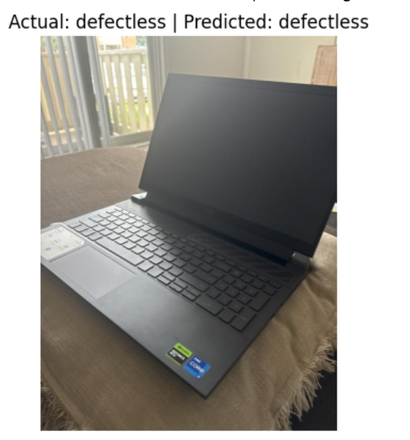
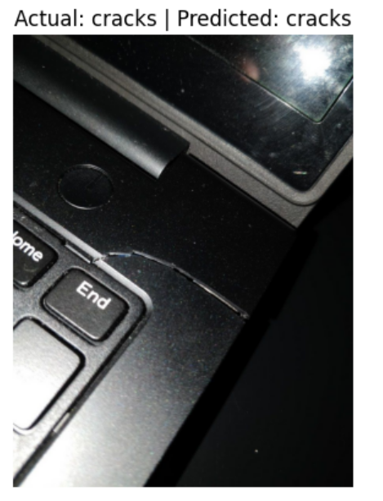
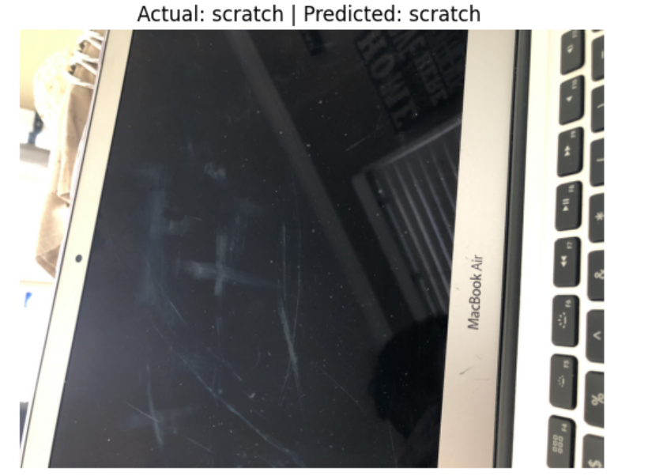
MobileNetv2

Slide 10
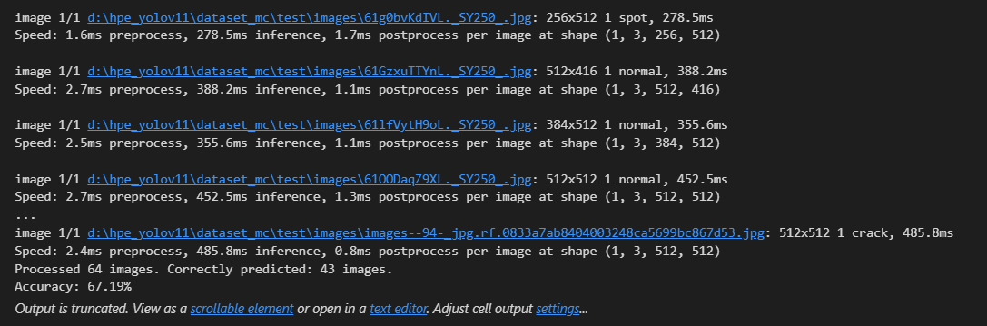
Yolov8- Accuracy score

Slide 11
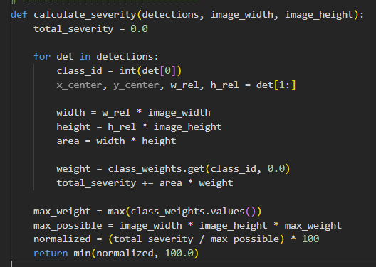
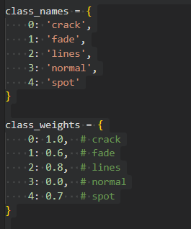
Yolov8- severity score calculation

Slide 12
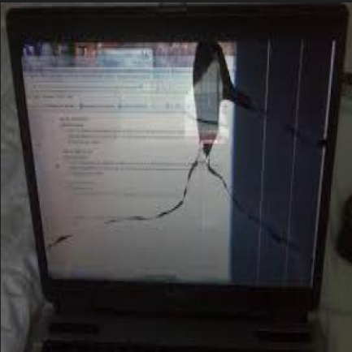
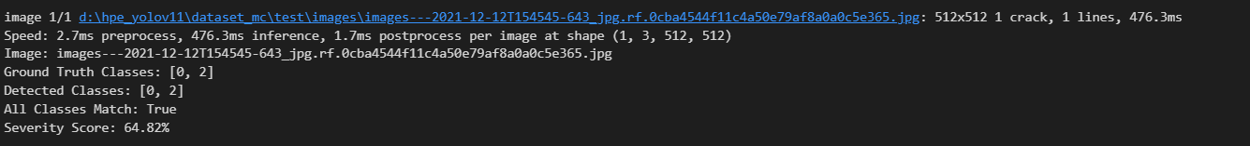
Yolov8- Defective laptops

Slide 13
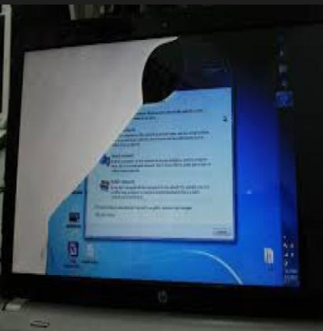
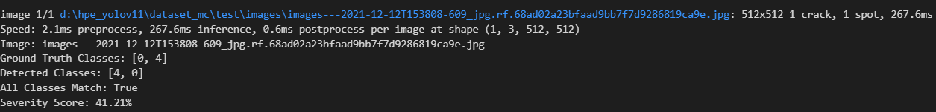
Yolov8- Defective laptops

